Slide 1
Computer Vision: Summary and Discussion
05/03/2011
Computer Vision
CS 543 / ECE 549
University of Illinois
Derek Hoiem

Slide 2
Announcements
Today is last day of regular class ☺
Poster session next Tuesday
  Reports due by Wed at noon
Derek and Ian out of town Wed afternoon through Friday
  I plan to be in office and available after class today (3:30-4:30) and Wed (10am-11am, 2pm-3pm)

Slide 3
Today’s class
Review of important concepts
Some important open problems
Feedback and course evaluation
Notes:
Tie together concepts that were disjoint in class. Make you aware of additional important concepts. Identify some major research problems.

Slide 4
Fundamentals of Computer Vision
Geometry
  How to relate world coordinates and image coordinates
Matching
  How to measure the similarity of two regions
Alignment
  How to align points/patches
  How to recover transformation parameters based on matched points
Grouping
  What points/regions/lines belong together?
Categorization
  What similarities are important?

Slide 5
Geometry
x = K [R t] X
  Maps 3d point X to 2d point x
  Rotation R and translation t map into 3D camera coordinates
  Intrinsic matrix K projects from 3D to 2D
Parallel lines in 3D converge at the vanishing point in the image
  A 3D plane has a vanishing line in the image
x’^{T} F x = 0
  Points in two views that correspond to the same 3D point are related by the fundamental matrix F

Slide 6
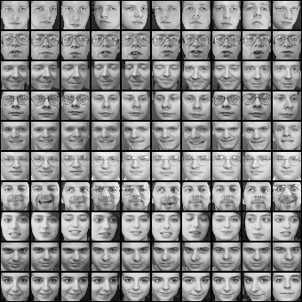

Matching
Does this patch match that patch?
  In two simultaneous views? (stereo)
  In two successive frames? (tracking, flow, SFM)
  In two pictures of the same object? (recognition)
?
?
Notes:
Add picture here

Slide 7
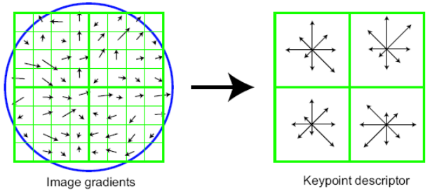
Matching
Representation: be invariant/robust to expected deformations but nothing else
Often assume that shape is constant
  Key cue: local differences in shading (e.g., gradients)
Change in viewpoint
  Rotation invariance: rotate and/or affine warp patch according to dominant orientations
Change in lighting or camera gain
  Average intensity invariance: oriented gradient-based matching
  Contrast invariance: normalize gradients by magnitude
Small translations
  Translation robustness: histograms over small regions
But can one representation do all of this?
SIFT: local normalized histograms of
oriented gradients provides robustness to
in-plane orientation, lighting, contrast, translation
HOG: like SIFT but does not rotate to dominant orientation

Slide 8
Alignment of points
Search: efficiently align matching patches
Interest points: find repeatable, distinctive points
  Long-range matching: e.g., wide baseline stereo, panoramas, object instance recognition
  Harris: points with strong gradients in orthogonal directions (e.g., corners) are precisely repeatable in x-y
  Difference of Gaussian: points with peak response in Laplacian image pyramid are somewhat repeatable in x-y-scale
Local search
  Short range matching: e.g., tracking, optical flow
  Gradient descent on patch SSD, often with image pyramid
Windowed search
  Long-range matching: e.g., recognition, stereo w/ scanline

Slide 9


Alignment of sets
Find transformation to align matching sets of points
Geometric transformation (e.g., affine)
  Least squares fit (SVD), if all matches can be trusted
  Hough transform: each potential match votes for a range of parameters
    Works well if there are very few parameters (3-4)
  RANSAC: repeatedly sample potential matches, compute parameters, and check for inliers
    Works well if fraction of inliers is high and few parameters (4-8)
Other cases
  Thin plate spline for more general distortions
  One-to-one correspondence (Hungarian algorithm)
B₃
A₁
A₃
A₂
B₂
B₁

Slide 10
Grouping
Clustering: group items (patches, pixels, lines, etc.) that have similar appearance
  Discretize continuous values; typically, represent points within cluster by center
  Improve efficiency: e.g., cluster interest points before recognition
  Summarize data
Segmentation: group pixels into regions of coherent color, texture, motion, and/or label
  Mean-shift clustering
  Watershed
  Graph-based segmentation: e.g., MRF and graph cuts
EM, mixture models: probabilistically group items that are likely to be drawn from the same distribution, while estimating the distributions’ parameters

Slide 11




Categorization
Match objects, parts, or scenes that may vary in appearance
Categories are typically defined by human and may be related by function, cost, or other non-visual attributes
Key problem: what are important similarities?
  Can be learned from training examples
Training Labels
Training Images
Image Features
Classifier Training
Trained Classifier

Slide 12
Categorization
Representation: ideally should be compact, comprehensive, direct
Histograms of quantized interest points (SIFT, HOG), color, texture
  Typical for image or region categorization
  Degree of spatial encoding is controllable by using spatial pyramids
HOG features at specified position
  Often used for finding parts or objects

Slide 13
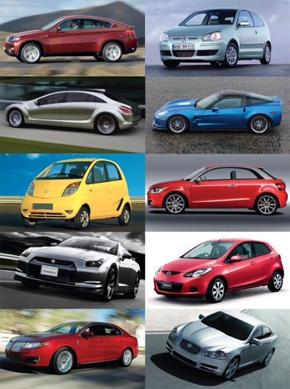
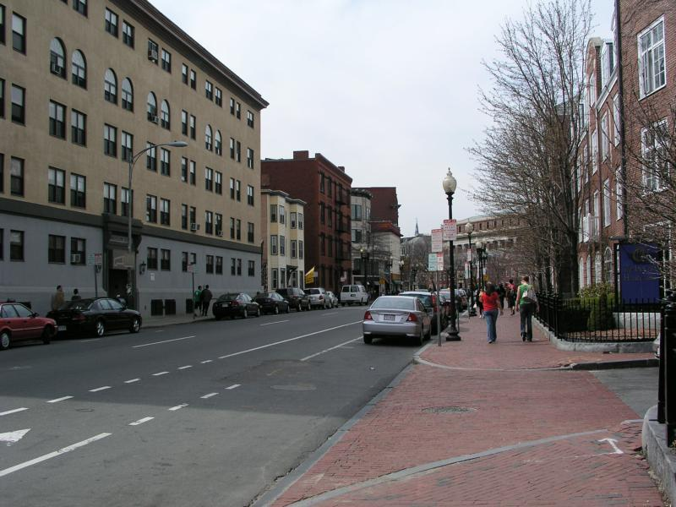
Object Categorization
Search by Sliding Window Detector
May work well for rigid objects
Key idea: simple alignment for simple deformations
Object or Background?

Slide 14

Object Categorization
Search by Parts-based model
Key idea: more flexible alignment for articulated objects
Defined by models of part appearance, geometry or spatial layout, and search algorithm

Slide 15
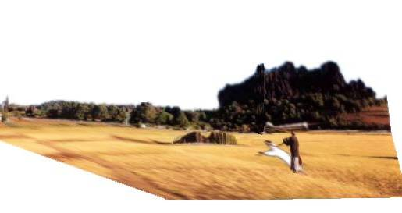
Vision as part of an intelligent system
3D Scene
Feature
Extraction
Texture
Color
Optical Flow
Stereo Disparity
Grouping
Surfaces
Bits of objects
Sense of depth
Motion patterns
Interpretation
Objects
Agents and goals
Shapes and properties
Open paths
Words
Action
Walk, touch, contemplate, smile, evade, read on, pick up, …

Slide 16
Important open problems
Computer vision is potentially worth major $$$, but there are major challenges to overcome first.
Driver assistance
  MobileEye received >$100M in funding from Goldman Sachs
Entertainment (Kinect, movies, etc.)
  Intel is spending $100M for visual computing over next five years
Security
  Potential for billions of deployed cameras
Robot workers
Many more

Slide 17
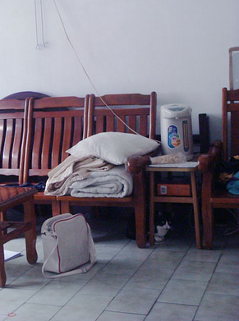
Important open problems
Object category recognition: where is the cat?

Slide 18
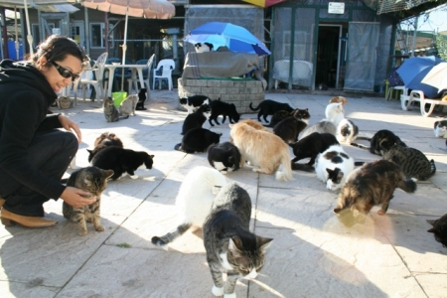
Important open problems
Object category recognition: where is the cat?
Important questions:
How can we better align two object instances?
How do we identify the important similarities of objects within a category?
How do we tell if two patches depict similar shapes?

Slide 19
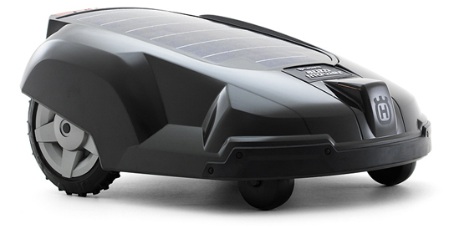
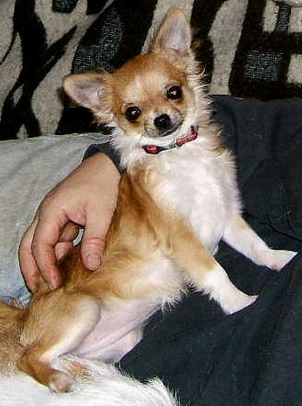
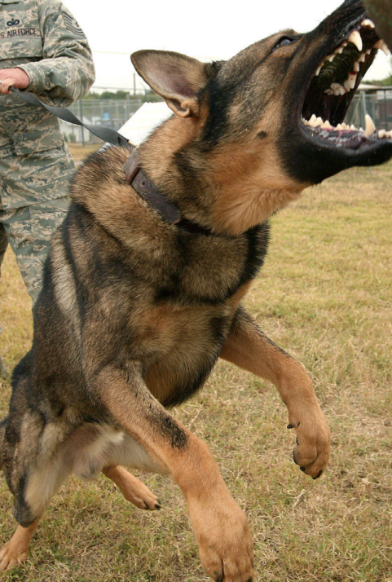

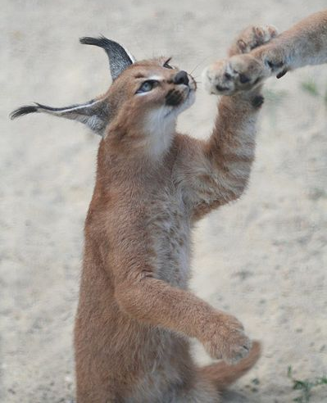

Important open problems
Object representation: what is it?

Slide 20
Important open problems
Object representation: what is it?
Important questions:
How can we pose recognition so that it lets us deal with new objects?
What do we want to predict or infer, and to what extent does that rely on categorization?
How do we transfer knowledge of one type of object to another?

Slide 21
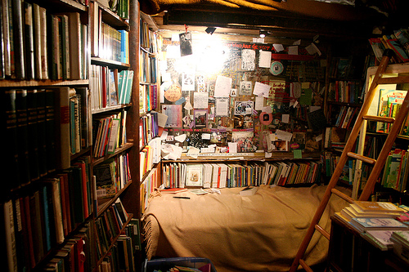
Important open problems
Spatial understanding: what is it doing? Or how do I do it?

Slide 22
Important open problems
Spatial understanding: what is it doing? Or how do I do it?
Important questions:
What are good representations of space for navigation and interaction? What kind of details are important?
How can we combine single-image cues with multi-view cues?

Slide 23
Important open problems
Algorithms: works pretty well → perfect
  E.g., stereo: top of wish list from Pixar guy Micheal Kass
Good directions:
Incorporate higher level knowledge

Slide 24
Important open problems
How should we adjust vision systems to solve particular tasks?

Slide 25
Important open problems
Can we build a “core” vision system that can easily be extended to perform new tasks or even learn on its own?
  What kind of representations might allow this?
  What should be built in and what should be learned?

Slide 26
If you want to learn more…
Read lots of papers: IJCV, PAMI, CVPR, ICCV, ECCV, NIPS
Helpful topics for classes
  David Forsyth’s optimization
  Classes in machine learning or pattern recognition
  Statistics, graphical models
  Seminar-style paper-reading classes
Just implement stuff, try demos, see what works

Slide 27
Feedback: very important
My custom form
ICES forms

Slide 28
See you next week!
Project posters on Tuesday
  Pizza provided
  Posters: 24” wide x 32” tall

